Slide 1
More Windows Forms

Slide 2
Overview
Polymorphism
Forms of Polymorphism in C#
Benefits of Polymorphism
Creating custom WinForms controls
Creating new WinForms windows
Sharing data between WinForms
Working with listbox in WinForms

Slide 3
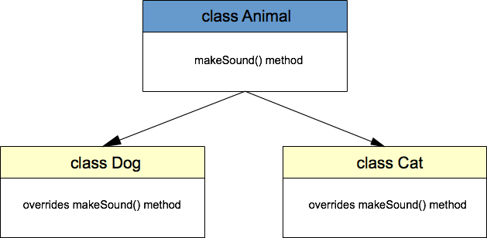
Polymorphism
Polymorphism originates from the Greek word “polys” which means many, and “morphe” which means forms, or shapes -(many forms).
Polymorphism is the ability of a reference variable to change behavior according to what object instance it is holding.
It allows multiple objects of different subclasses to be treated as object of a single super class, while automatically selecting the proper methods to apply to a particular object based on the subclass it belongs to.

Slide 4
Forms of Polymorphism in C#
Method overriding
Methods of a subclass override the methods of a superclass
Method overriding (implementation) of the abstract methods
Methods of a subclass implement the abstract methods of an abstract class
Method overriding(implementation) through a C# interface
Methods of a concrete class implement the methods of the interface

Slide 5
Benefits of Polymorphism
If you need to write code that deals with a family of types, the code can ignore type-specific details and just interact with the base type of the family.
Even though the code think it is using an object of the base class, the object class could actually be the base class or any of its subclasses.
This makes your code easier for you to write and easier for others to understand.

Slide 6
Creating custom WinForms controls
WinForms allows you to create custom controls by using inheritance and polymorphism.
The benefit of creating custom controls are that it allows creating blueprints for a control with specific behavior that can be used in multiple places.
Custom controls are created by inheriting the base control type, granting you the ability to override the base-class methods.

Slide 7
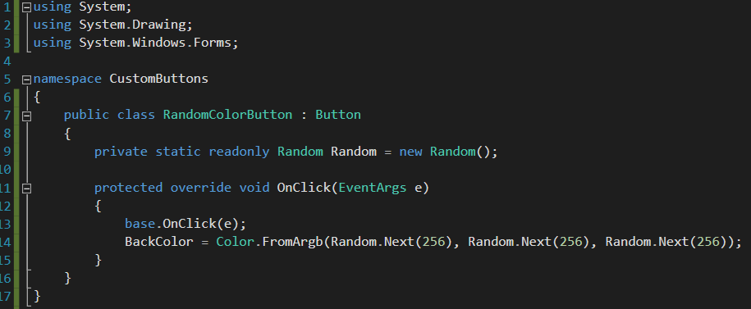
Example of a custom button

Slide 8
Exercise custom button
Try to create a custom button, you can either pick the inherit from button or inherit from control.
The only requirement for the task, is that you create a custom styled button that can be used in multiple places.

Slide 9

Creating new WinForms windows
In many cases you want to create multiple forms with a specific purpose.
Creating a new form is as simple, as defining it and thereafter creating a new instance of it, followed by calling the “Show” method on the form object.

Slide 10
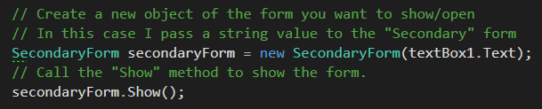
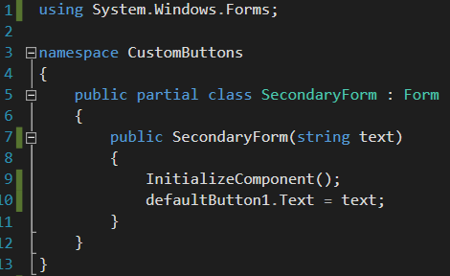
Sharing data between WinForms
Often you want to share data between forms.
The simplest is to pass the values into the other forms constructor.
Remember that a string is call by reference and a object is call by reference, therefore if you want the data to be shared back you should use objects instead.

Slide 11
Exercise creating new form and sharing data
Create a windows forms application
Create a Customer class with the following properties
Name
Age
Create a new form and make a button that can open the new form
Create a new Customer object and pass it to the second form. Display the properties of the Customer object in the second form using either labels og textboxes.

Slide 12
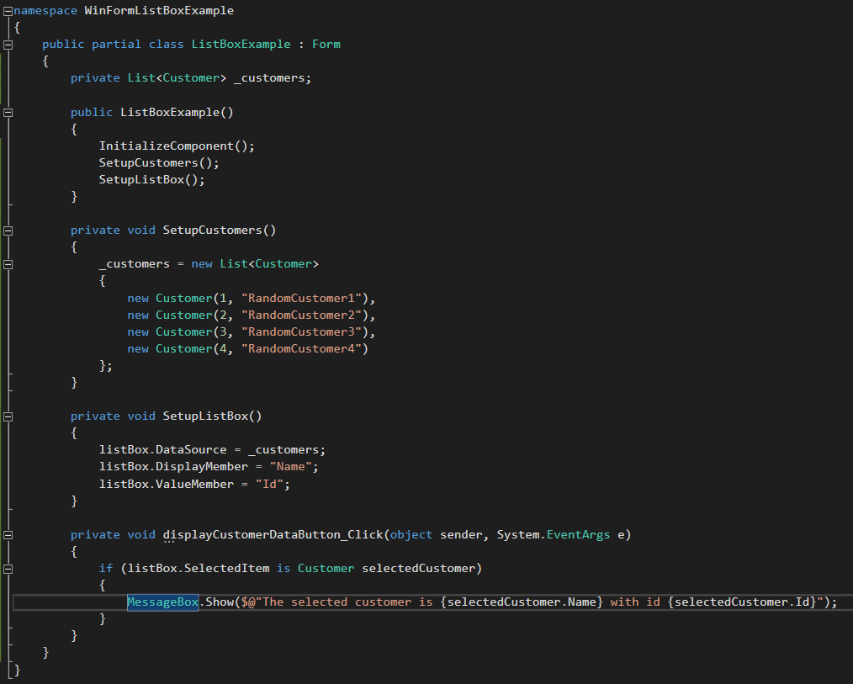
Working with lists in WinForms

Slide 13
Exercise list box
Create a WinForms application with two forms.
Create a Product class with the properties Id, Name and Price
Make a list of Products and display them in a list box, displaying the names of the products.
Make it so you can select a product and click a button (update button), that passes the selected product into the other forms constructor.
In the new form you should be able to update the product Price using a text field and a button.
Make it so you can click another button on the main form, that displays the product information using the Show() method on the Messagebox type.

